Slide 1

Stat 9890 Regression Project
Comparing Ridge, Lasso, Elastic Net and Random Forest
BY OJE WILLIAMS

Slide 2
introduction
The data for this project was collected from: https://www.kaggle.com/miroslavsabo/young-people-survey/data
It was based on a 2013 survey of statistics students of Slovakian nationality, aged between 15-30 at FSEV UK.
It contained a series of responses based on certain questions.
The data file (responses.csv) consists of 1010 rows and 150 columns (139 integer and 11 categorical).
The data had missing values, into which the column means were imputed.
After processing the p = 52 and n =1010
The response variable was height and the predictors were variables measuring music/movie preferences as well as fears
Notes:
Music preferences (19 items) Movie preferences (12 items)Hobbies & interests (32 items)Phobias (10 items)Health habits (3 items)Personality traits, views on life, & opinions (57 items)Spending habits (7 items)Demographics (10 items)… No standardization , mainly categorical data.

Slide 3
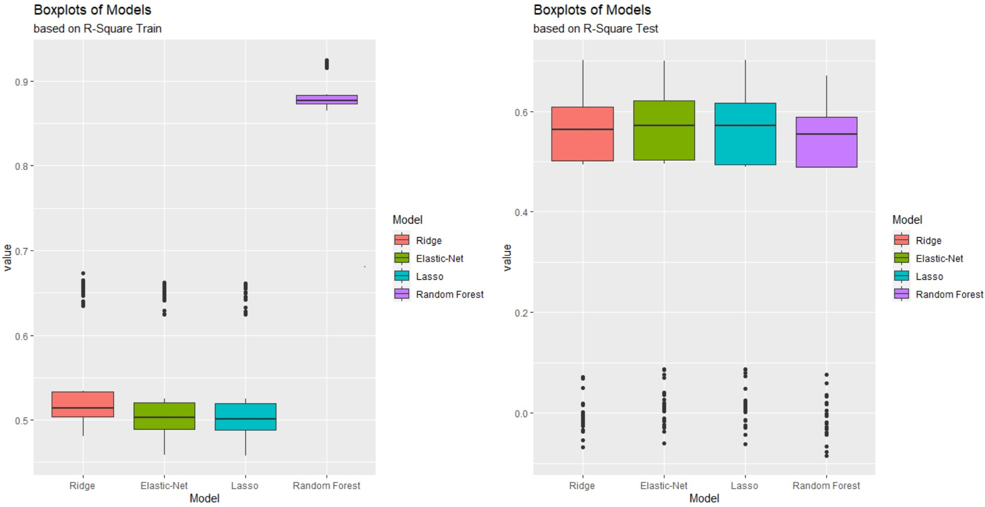
boxplots of R²_{test} and R²_{train}

Slide 4
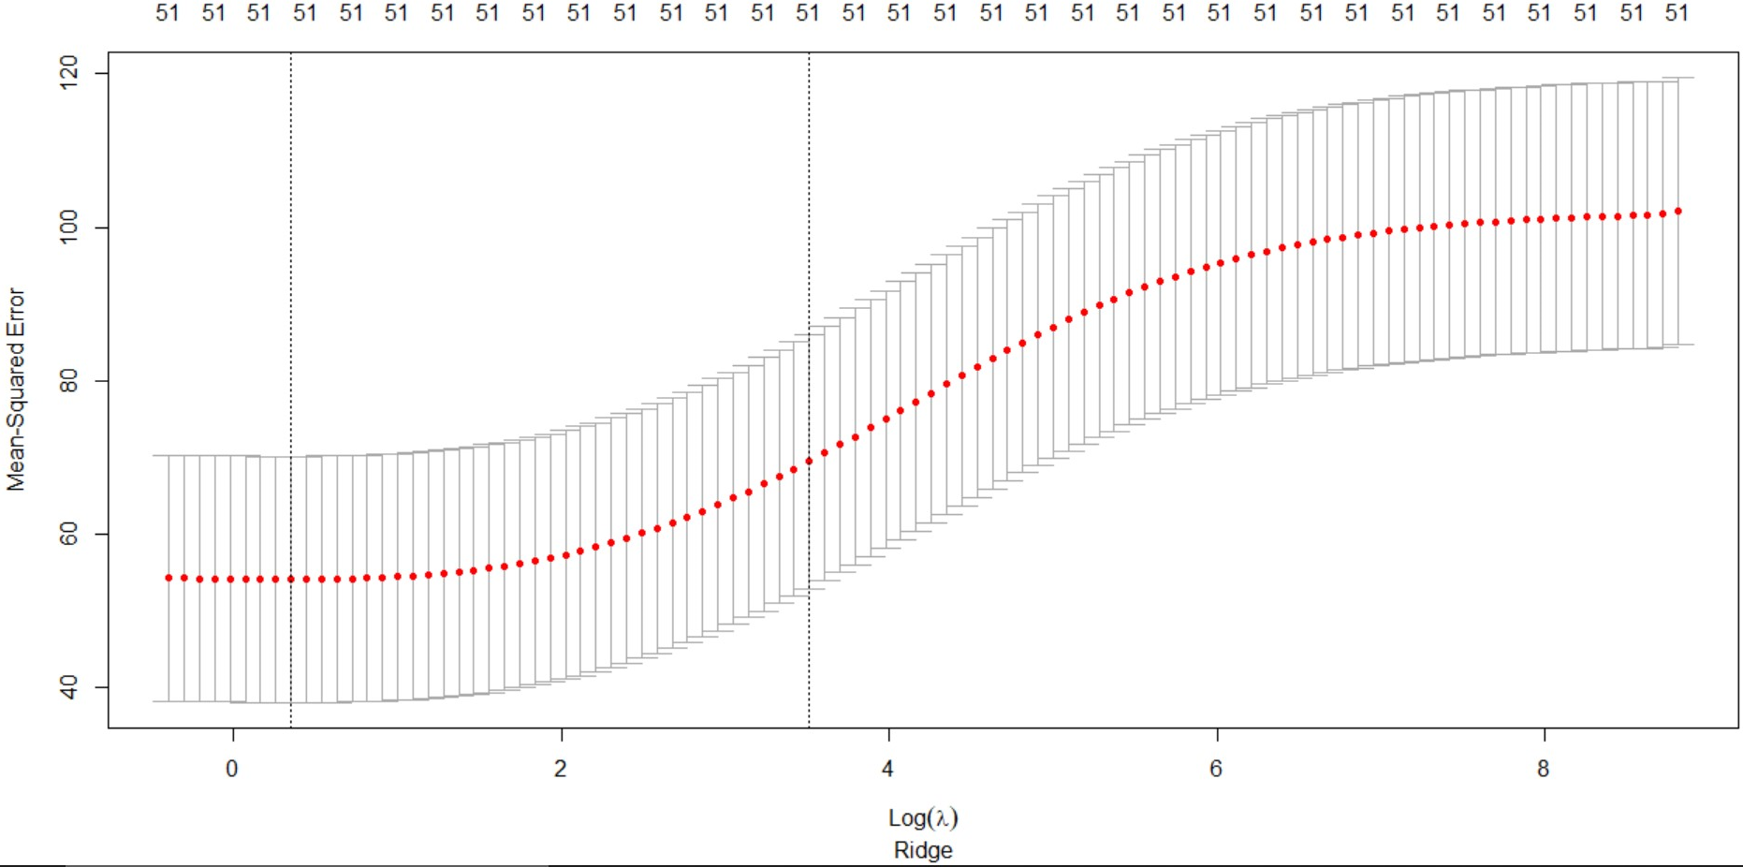
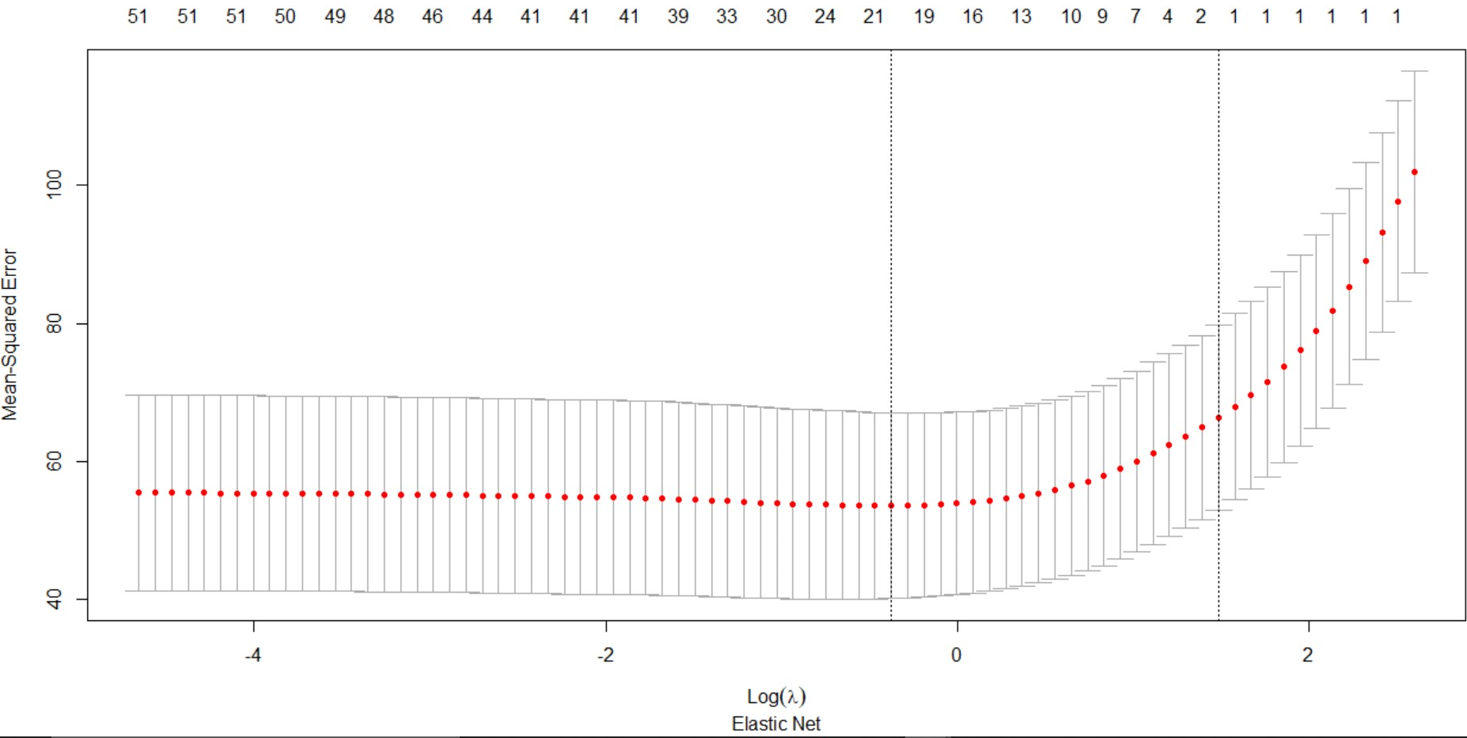
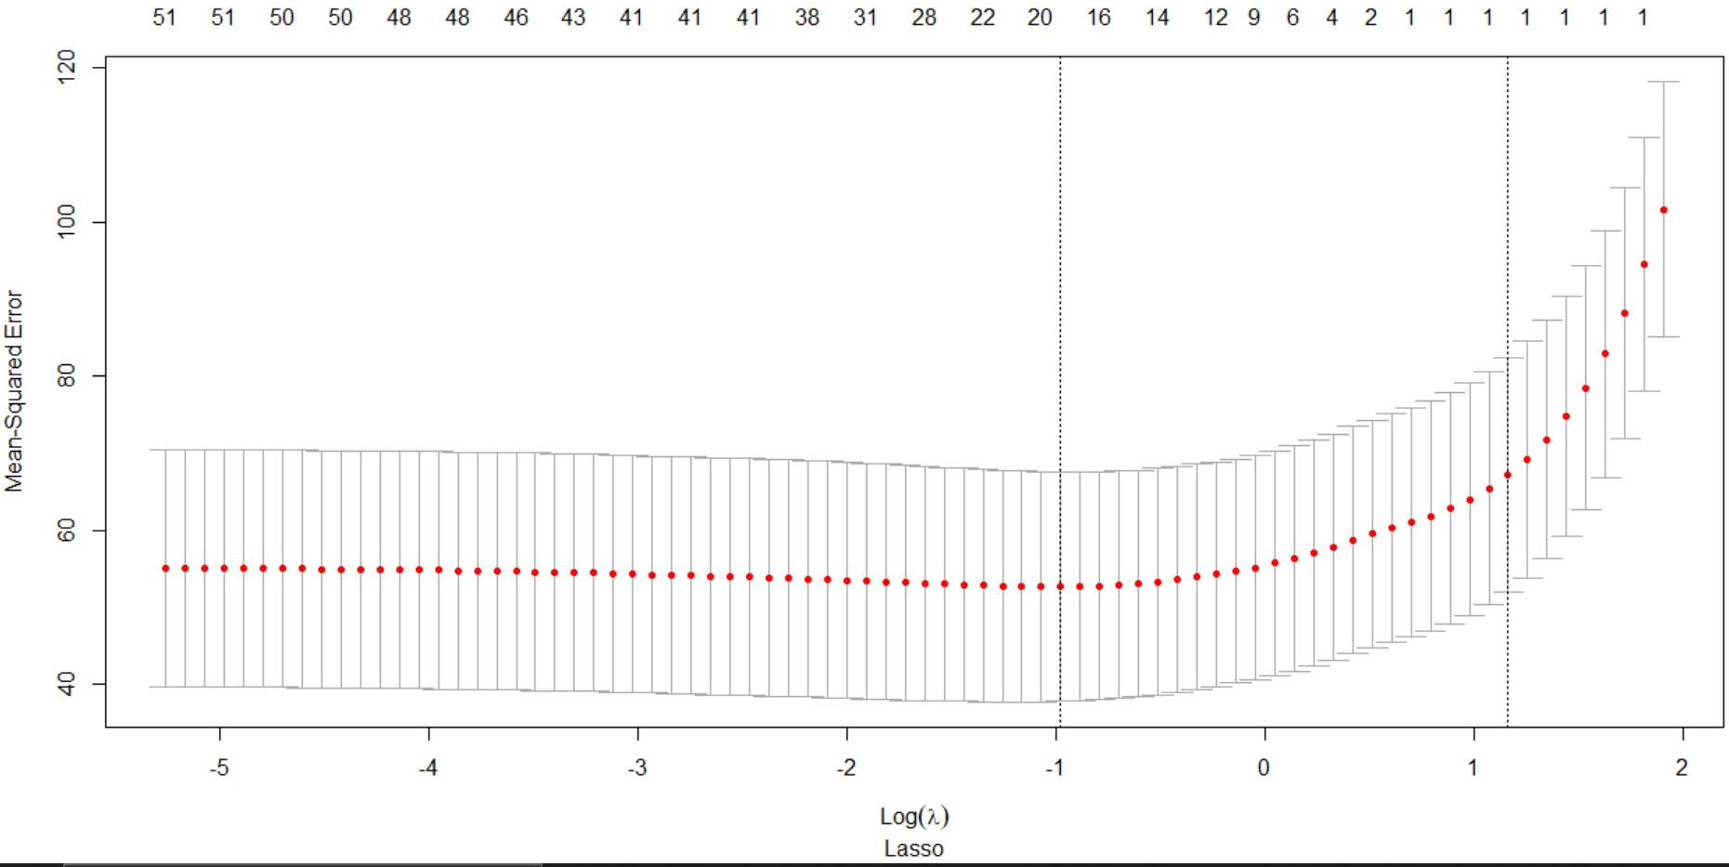
10-Fold Cross Validation Curves

Slide 5
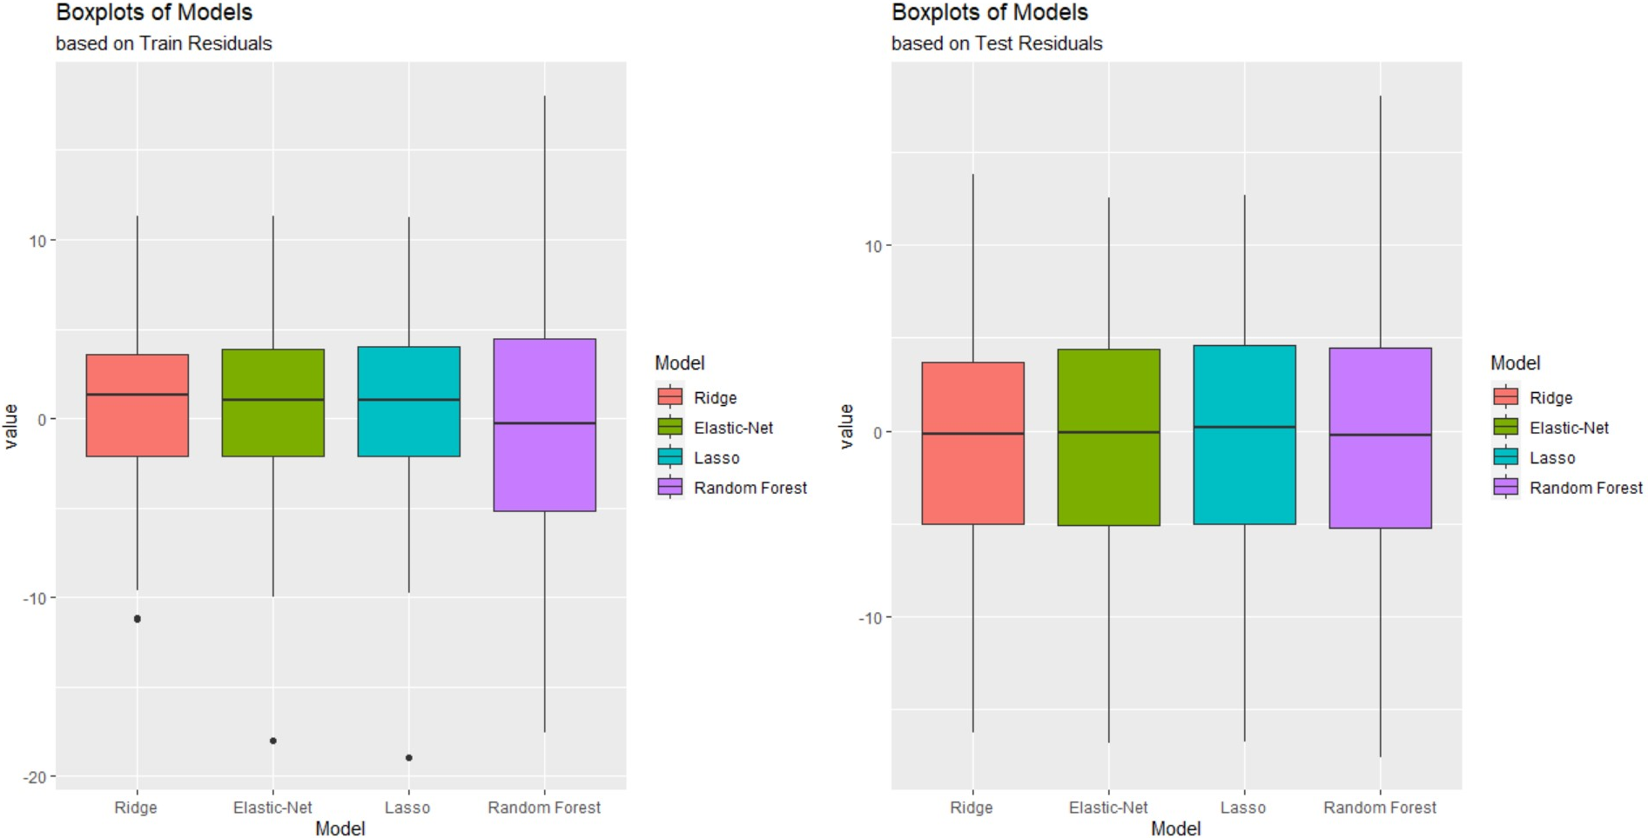
Train and Residual Boxplots

Slide 6
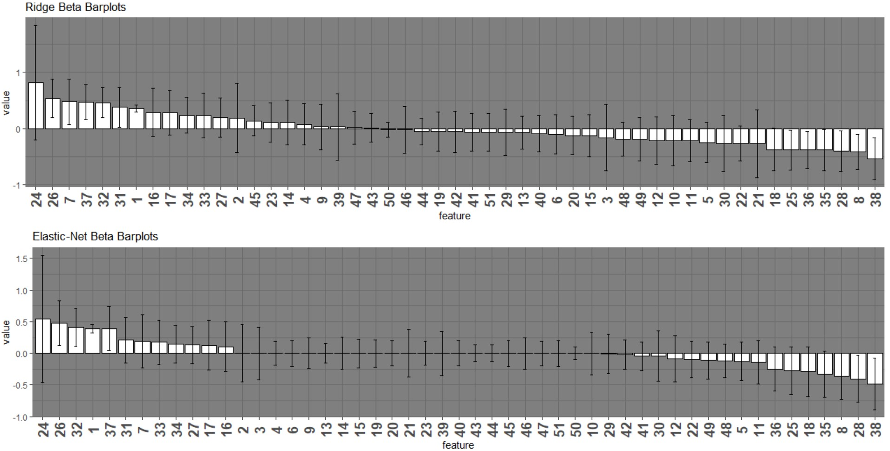
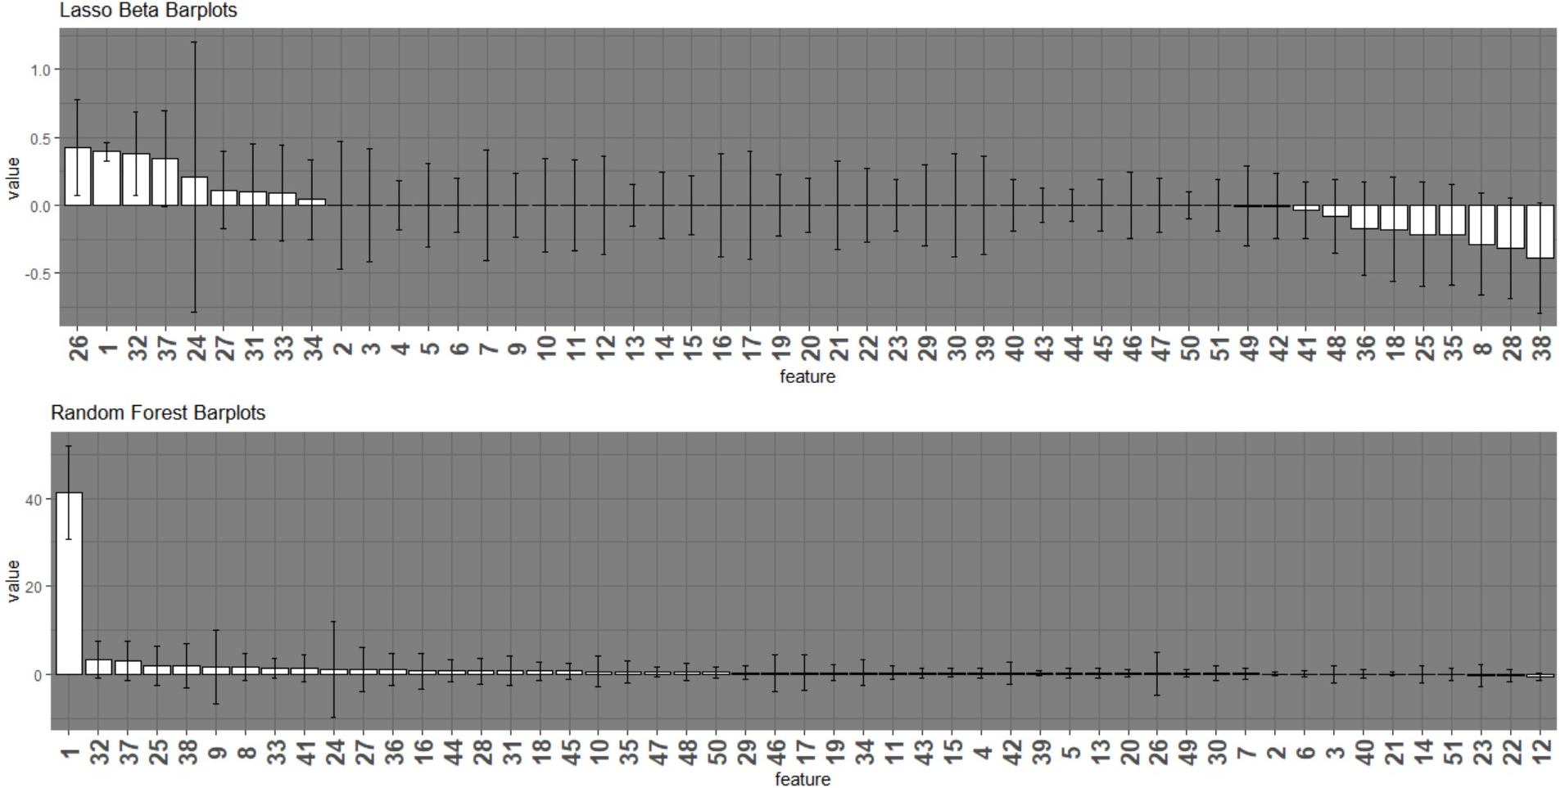
Bar-plots of Estimated Coefficients
Legend
1 – Weight, 2–Interest in Music, (3- 21) Level of interest in Music Genre, 3- Slow/Fast Songs, 4-Dance, 5- Folk, 6- Country, 7-Classical, 8-Musical, 9-Pop, 10-Rock, 11-Metal/HardRock, 12-Punk, 13-Hiphop/Rap, 14-Reggae/Ska, 15-Jazz/Swing, 16-RocknRoll, 17-Alternative, 18-Techno, 19-Opera, 20-Interest in Movies, (21-31) Level of interest in Music Genre, 22-Horror, 23-Thriller, 24-Comedy, 25-Romantic, 26-Sci-fi, 27-War, 28-Fantasy, 29-Animated, 30-Documentary, 31-Western, (32-39) Leisure activities, 32-Cars, 33-Passive Sport, 34-Active Sport, 35-Gardening, 36-Shopping, 37-Science and Technology, 38-Theatre, 39-Fun with Friends(40-49) Fears 40-Flying, 41-Storm, 42-Darkness, 43-Heights, 44-Spiders, 45-Snakes, 46-Rats, 47-Ageing, 48-Dogs, 49-Public Speaking, 50-Age, 51-Number of Siblings.

Slide 7
Summary
The total runtime for project was 12 mins
The total time to run all models 5mins
Total time for Bootstrap 7 mins
Ridge | Elastic Net | Lasso | Random Forest
Min Time .1 secs | Min Time .1 secs | Min Time .1 secs | Min Time 0 secs
Avg Time 2.5 secs | Avg Time 3.8 secs | Avg Time 1.7 secs | Avg Time 19 secs
Max Time 31 secs | Max Time 32 secs | Max Time 39 secs | Max Time 2.7mins

